Slide 1



Ch 3.1: Second Order Linear Homogeneous Equations with Constant Coefficients
A second order ordinary differential equation has the general form
where f is some given function.
This equation is said to be linear if f is linear in y and y':
Otherwise the equation is said to be nonlinear.
A second order linear equation often appears as
If G(t) = 0 for all t, then the equation is called homogeneous. Otherwise the equation is nonhomogeneous.

Slide 2


Homogeneous Equations, Initial Values
In Sections 3.6 and 3.7, we will see that once a solution to a homogeneous equation is found, then it is possible to solve the corresponding nonhomogeneous equation, or at least express the solution in terms of an integral.
The focus of this chapter is thus on homogeneous equations; and in particular, those with constant coefficients:
We will examine the variable coefficient case in Chapter 5.
Initial conditions typically take the form
Thus solution passes through (t₀, y₀), and slope of solution at (t₀, y₀) is equal to y₀'.

Slide 3



Example 1: Infinitely Many Solutions (1 of 3)
Consider the second order linear differential equation
Two solutions of this equation are
Other solutions include
Based on these observations, we see that there are infinitely many solutions of the form
It will be shown in Section 3.2 that all solutions of the differential equation above can be expressed in this form.

Slide 4

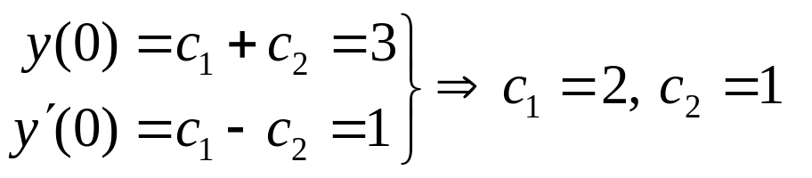
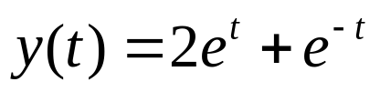
Example 1: Initial Conditions (2 of 3)
Now consider the following initial value problem for our equation:
We have found a general solution of the form
Using the initial equations,
Thus

Slide 5
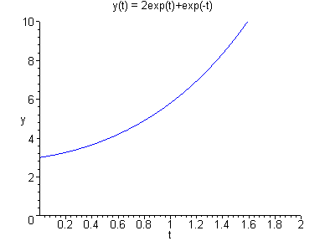
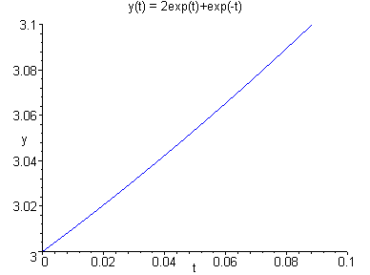
Example 1: Solution Graphs (3 of 3)
Our initial value problem and solution are
Graphs of this solution are given below. The graph on the right suggests that both initial conditions are satisfied.

Slide 6




Characteristic Equation
To solve the 2nd order equation with constant coefficients,
we begin by assuming a solution of the form y = e^{rt}.
Substituting this into the differential equation, we obtain
Simplifying,
and hence
This last equation is called the characteristic equation of the differential equation.
We then solve for r by factoring or using quadratic formula.

Slide 7

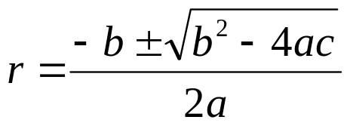
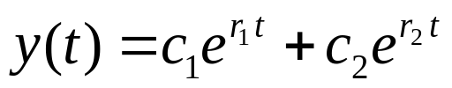
General Solution
Using the quadratic formula on the characteristic equation
we obtain two solutions, r₁ and r₂.
There are three possible results:
  The roots r₁, r₂ are real and r₁ ≠ r₂.
  The roots r₁, r₂ are real and r₁ = r₂.
  The roots r₁, r₂ are complex.
In this section, we will assume r₁, r₂ are real and r₁ ≠ r₂.
In this case, the general solution has the form

Slide 8

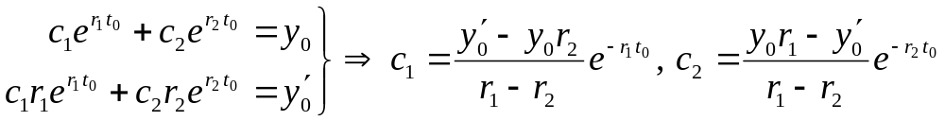
Initial Conditions
For the initial value problem
we use the general solution
together with the initial conditions to find c₁ and c₂. That is,
Since we are assuming r₁ ≠ r₂, it follows that a solution of the form y = e^{rt} to the above initial value problem will always exist, for any set of initial conditions.

Slide 9

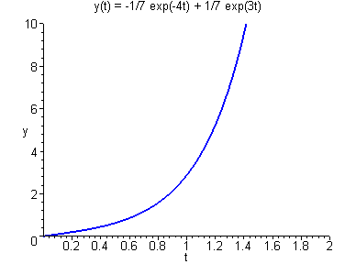
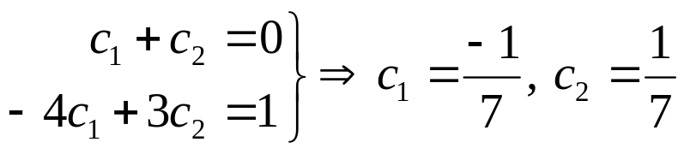
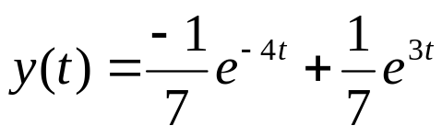
Example 2
Consider the initial value problem
Assuming exponential soln leads to characteristic equation:
Factoring yields two solutions, r₁ = -4 and r₂ = 3
The general solution has the form
Using the initial conditions:
Thus

Slide 10

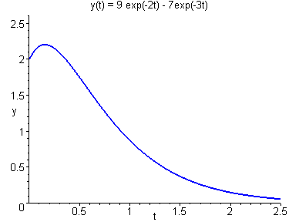
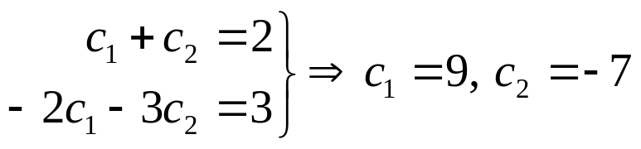

Example 4: Initial Value Problem (1 of 2)
Consider the initial value problem
Then
Factoring yields two solutions, r₁ = -2 and r₂ = -3
The general solution has the form
Using initial conditions:
Thus

Slide 11
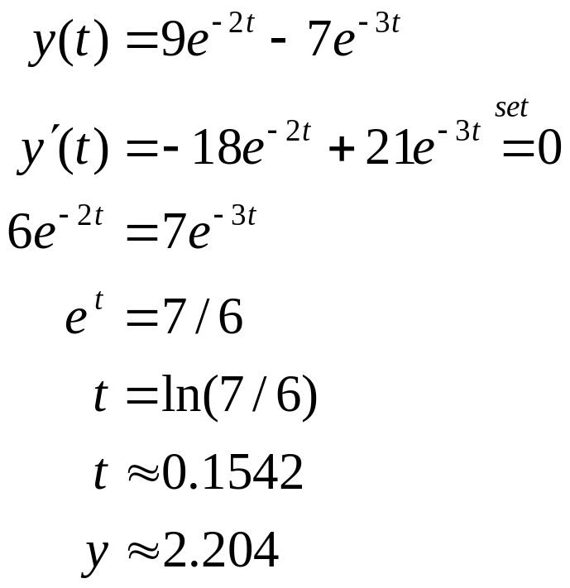
Example 4: Find Maximum Value (2 of 2)
Find the maximum value attained by the solution.

